Slide 1
Farmland Project
Will Callan

Slide 2
Specific Conservation Problems
Specific Problems:
Fields 1 and 2-3 are sloped making farming difficult and erosion is a problem
Fields 4 and 5 are overgrazed
Field 7 has lots of runoff

Slide 3
Specific Conservation Improvements

Slide 4
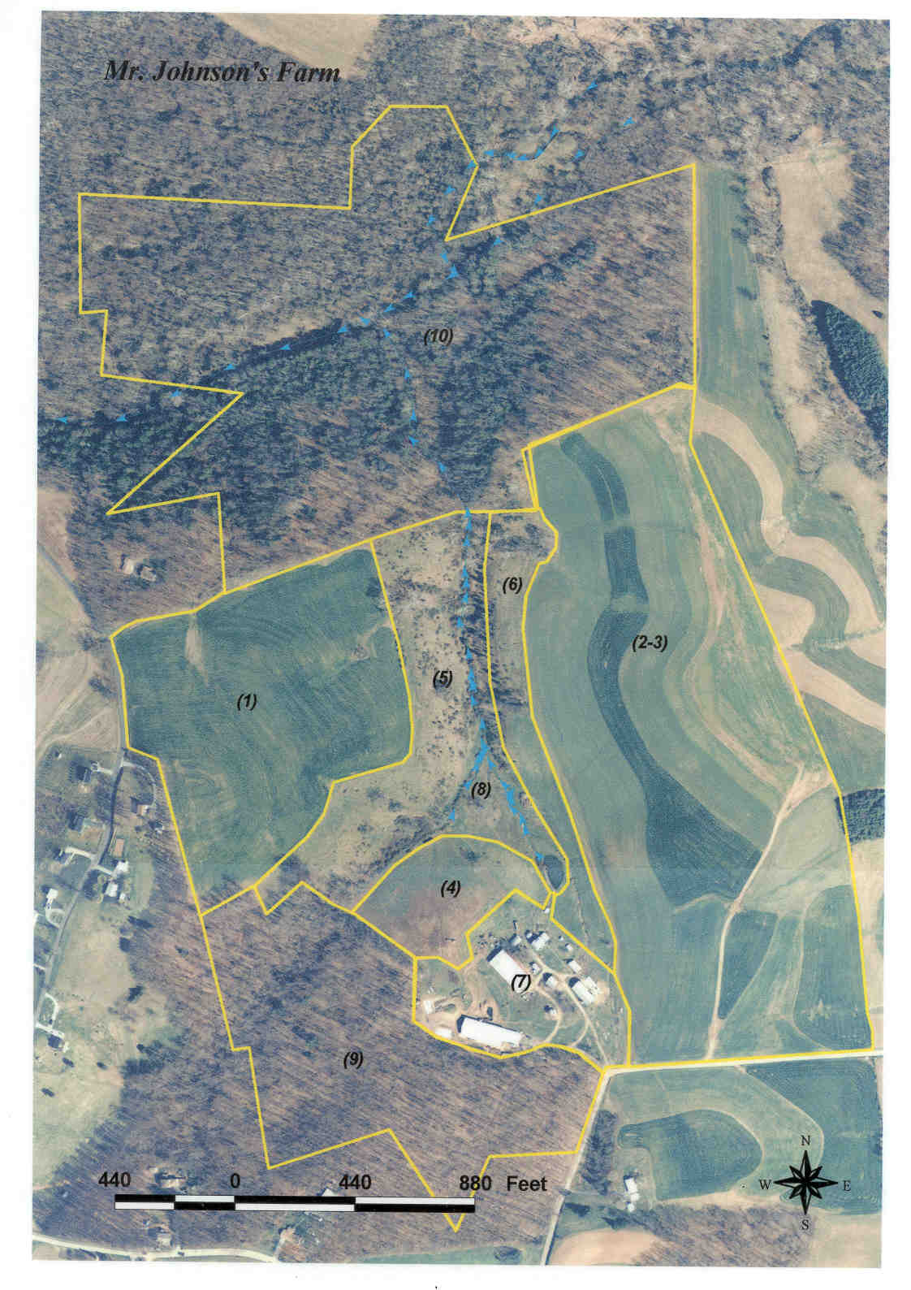

Slide 6
Agribusiness 1: Sunflower Seeds
Important Events:
100-110 days to harvest seeds, slightly longer than oil types
Can be planted slightly before last frost but I would do May 1st
Thrive in hot summers
Type: Royal Hybrid
7 feet tall, 8 inches in head diameter
Harvest when head is turning yellow/brown and petals drying
100-110 days is mid/late august

Slide 7
Year 1
Year 1
Year 2 extension
Year 1

Slide 8

Costs
Seeds: 100,000 seeds is 5.5 acres
$\frac{100,000 seeds}{5.5 acres} ×16 acres=272,727 seeds$
100,000 seeds cost 347 dollars
$\frac{347 dollars}{100,000 seeds} ×300,000 seeds=1,041 dollars$
$\frac{2,000 lb}{acre}×15 acres ×\frac{\$20.00}{100 lb}=\$6,000$

Slide 9

Profits
Year 1: $6,000 −1,041(seed cost)−2,000(combine rental?)$ = 2,959
For year 2 I will increase the acreage by including fields and 2-3
Year 2: $13,200 −2,082(seed cost)−4000(combine rental?)$ =7,118

Slide 10
Timeline
January
March
April
May
June
February
Order seeds
Plant Seeds
Last frost possible
Last frost possible
July
September
October
November
December
August
Mid September harvest sunflower heads
Plan for increasing field size

Slide 11
Agribusiness 2: Pumpkins
I need to be careful about how many I produce, customers may not buy all of them.
Type: Renegade PMR
18 lbs., 2-3 fruits per plant
90- 120 days to grow
Start later than the start of the growing season so they are ripe in October when popularity is high
Store in a cool place

Slide 12
Year 2 Location and possible extension area
Year 1 (half acre)

Slide 13
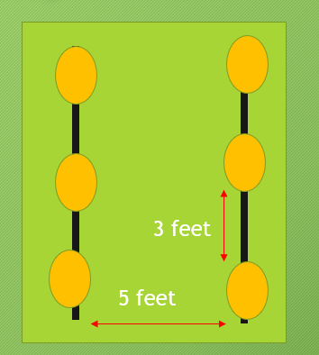
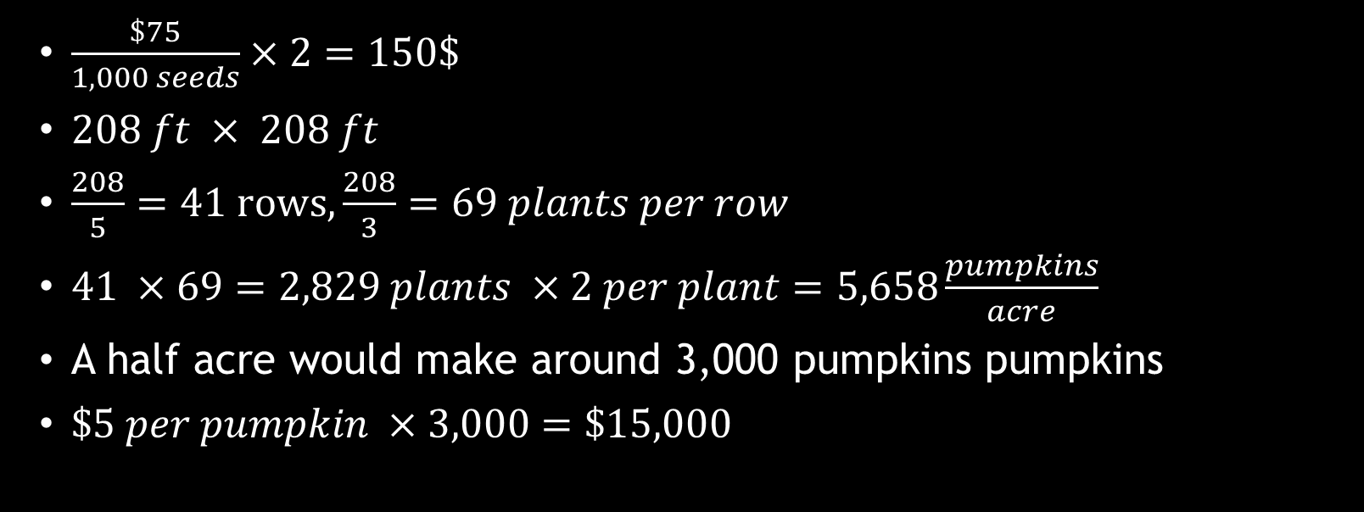
Calculations
$\frac{\$75}{1,000 seeds}×2=150\$$
$208 ft × 208 ft$
$\frac{208}{5}=41 rows,\frac{208}{3}=69 plants per row$
$41 ×69=2,829 plants ×2 per plant=5,658\frac{pumpkins}{acre}$
A half acre would make around 3,000 pumpkins pumpkins
$\$5 per pumpkin ×3,000=\$15,000$

Slide 14
Profit
First Year: 15,000 – 150(seed cost) – 150(Fertilizer?) = 14,700
In year 2 I would re-evaluate how many pumpkins I can plant and sell, possibly increasing acreage. I would also look into other avenues besides selling directly to customers.

Slide 15
Timeline
January
March
April
May
June
February
Last frost possible
Last frost possible
Prepare fields
July
September
October
November
December
August
Plant seeds and fertilize
Plan for increasing number of pumpkins
Start harvesting pumpkins and selling them

